Slide 1
Introducing Programming with an Example
Computing the Area of a Circle

Slide 2
Trace a Program Execution
animation
allocate memory for radius
public class ComputeArea {
/** Main method */
public static void main(String[] args) {
double radius;
double area;
// Assign a radius
radius = 20;
// Compute area
area = radius * radius * 3.14159;
// Display results
System.out.println("The area for the circle of radius " +
radius + " is " + area);
}
}
radius
no value

Slide 3
Trace a Program Execution
animation
public class ComputeArea {
/** Main method */
public static void main(String[] args) {
double radius;
double area;
// Assign a radius
radius = 20;
// Compute area
area = radius * radius * 3.14159;
// Display results
System.out.println("The area for the circle of radius " +
radius + " is " + area);
}
}
memory
radius
no value
area
no value
allocate memory for area

Slide 4
Trace a Program Execution
animation
public class ComputeArea {
/** Main method */
public static void main(String[] args) {
double radius;
double area;
// Assign a radius
radius = 20;
// Compute area
area = radius * radius * 3.14159;
// Display results
System.out.println("The area for the circle of radius " +
radius + " is " + area);
}
}
assign 20 to radius
radius
20
area
no value

Slide 5
Trace a Program Execution
animation
public class ComputeArea {
/** Main method */
public static void main(String[] args) {
double radius;
double area;
// Assign a radius
radius = 20;
// Compute area
area = radius * radius * 3.14159;
// Display results
System.out.println("The area for the circle of radius " +
radius + " is " + area);
}
}
memory
radius
20
area
1256.636
compute area and assign it to variable area

Slide 6

Trace a Program Execution
animation
public class ComputeArea {
/** Main method */
public static void main(String[] args) {
double radius;
double area;
// Assign a radius
radius = 20;
// Compute area
area = radius * radius * 3.14159;
// Display results
System.out.println("The area for the circle of radius " +
radius + " is " + area);
}
}
memory
radius
20
area
1256.636
print a message to the console

Slide 7
Reading Input from the Console
1. Create a Scanner object
  Scanner input = new Scanner(System.in);
2. Use the method nextDouble() to obtain to a double value. For example,
  System.out.print("Enter a double value: ");
  Scanner input = new Scanner(System.in);
  double d = input.nextDouble();
ComputeAreaWithConsoleInput
Run
ComputeAverage
Run

Slide 8
Identifiers
An identifier is a sequence of characters that consist of letters, digits, underscores (_), and dollar signs ($).
An identifier must start with a letter, an underscore (_), or a dollar sign ($). It cannot start with a digit.
An identifier cannot be a reserved word. (See Appendix A, “Java Keywords,” for a list of reserved words).
An identifier cannot be true, false, or
null.
An identifier can be of any length.

Slide 9
Variables
// Compute the first area
radius = 1.0;
area = radius * radius * 3.14159;
System.out.println("The area is “ + area + " for radius "+radius);
// Compute the second area
radius = 2.0;
area = radius * radius * 3.14159;
System.out.println("The area is “ + area + " for radius "+radius);

Slide 10
Declaring Variables
int x; // Declare x to be an
// integer variable;
double radius; // Declare radius to
// be a double variable;
char a; // Declare a to be a
// character variable;

Slide 11
Assignment Statements
x = 1; // Assign 1 to x;
radius = 1.0; // Assign 1.0 to radius;
a = 'A'; // Assign 'A' to a;

Slide 12
Declaring and Initializing in One Step
int x = 1;
double d = 1.4;

Slide 13
Named Constants
final datatype CONSTANTNAME = VALUE;
final double PI = 3.14159;
final int SIZE = 3;

Slide 14
Naming Conventions
Choose meaningful and descriptive names.
Variables and method names:
  Use lowercase. If the name consists of several words, concatenate all in one, use lowercase for the first word, and capitalize the first letter of each subsequent word in the name. For example, the variables radius and area, and the method computeArea.

Slide 15
Naming Conventions, cont.
Class names:
  Capitalize the first letter of each word in the name. For example, the class name ComputeArea.
Constants:
  Capitalize all letters in constants, and use underscores to connect words. For example, the constant PI and MAX_VALUE

Slide 16

Numerical Data Types

Slide 17
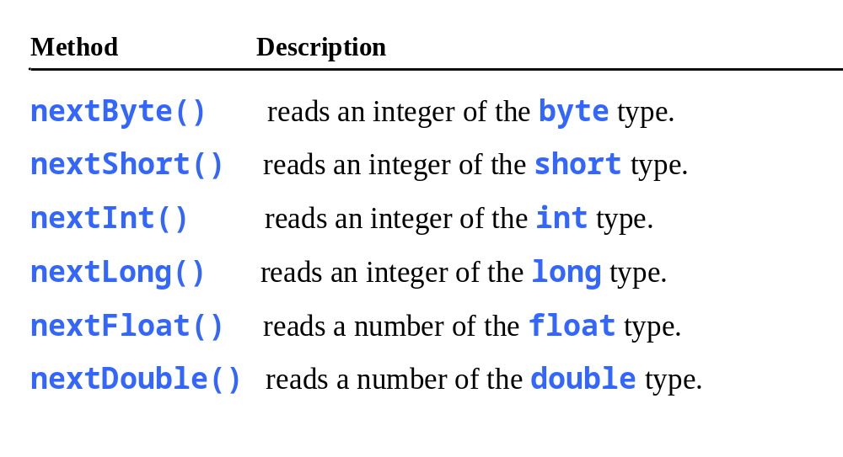
Reading Numbers from the Keyboard
Scanner input = new Scanner(System.in);
int value = input.nextInt();

Slide 18

Numeric Operators

Slide 19
Integer Division
+, -, *, /, and %
5 / 2 yields an integer 2.
5.0 / 2 yields a double value 2.5
5 % 2 yields 1 (the remainder of the division)

Slide 20

Remainder Operator
Remainder is very useful in programming. For example, an even number % 2 is always 0 and an odd number % 2 is always 1. So you can use this property to determine whether a number is even or odd. Suppose today is Saturday and you and your friends are going to meet in 10 days. What day is in 10 days? You can find that day is Tuesday using the following expression:

Slide 21
Problem: Displaying Time
Write a program that obtains minutes and remaining seconds from seconds.

Slide 22
NOTE
Calculations involving floating-point numbers are approximated because these numbers are not stored with complete accuracy. For example,
System.out.println(1.0 - 0.1 - 0.1 - 0.1 - 0.1 - 0.1);
displays 0.5000000000000001, not 0.5, and
System.out.println(1.0 - 0.9);
displays 0.09999999999999998, not 0.1. Integers are stored precisely. Therefore, calculations with integers yield a precise integer result.

Slide 23
Exponent Operations
System.out.println(Math.pow(2, 3));
// Displays 8.0
System.out.println(Math.pow(4, 0.5));
// Displays 2.0
System.out.println(Math.pow(2.5, 2));
// Displays 6.25
System.out.println(Math.pow(2.5, -2));
// Displays 0.16

Slide 24
Number Literals
A literal is a constant value that appears directly in the program. For example, 34, 1,000,000, and 5.0 are literals in the following statements:
int i = 34;
long x = 1000000;
double d = 5.0;

Slide 25
Integer Literals
An integer literal can be assigned to an integer variable as long as it can fit into the variable. A compilation error would occur if the literal were too large for the variable to hold. For example, the statement byte b = 1000 would cause a compilation error, because 1000 cannot be stored in a variable of the byte type.
An integer literal is assumed to be of the int type, whose value is between -2³¹ (-2147483648) to 2³¹–1 (2147483647). To denote an integer literal of the long type, append it with the letter L or l. L is preferred because l (lowercase L) can easily be confused with 1 (the digit one).

Slide 26
Floating-Point Literals
Floating-point literals are written with a decimal point. By default, a floating-point literal is treated as a double type value. For example, 5.0 is considered a double value, not a float value. You can make a number a float by appending the letter f or F, and make a number a double by appending the letter d or D. For example, you can use 100.2f or 100.2F for a float number, and 100.2d or 100.2D for a double number.

Slide 27
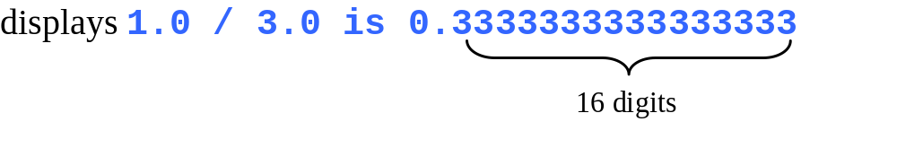
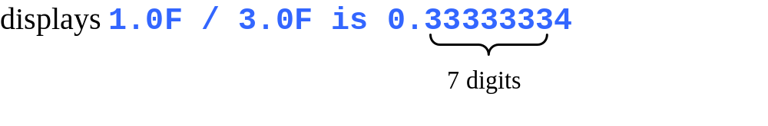
double vs. float
The double type values are more accurate than the float type values. For example,
System.out.println("1.0 / 3.0 is " + 1.0 / 3.0);
System.out.println("1.0F / 3.0F is " + 1.0F / 3.0F);

Slide 28
Scientific Notation
Floating-point literals can also be specified in scientific notation, for example, 1.23456e+2, same as 1.23456e2, is equivalent to 123.456, and 1.23456e-2 is equivalent to 0.0123456. E (or e) represents an exponent and it can be either in lowercase or uppercase.

Slide 29

Arithmetic Expressions
is translated to
(3+4*x)/5 – 10*(y-5)*(a+b+c)/x + 9*(4/x + (9+x)/y)

Slide 30

How to Evaluate an Expression
Though Java has its own way to evaluate an expression behind the scene, the result of a Java expression and its corresponding arithmetic expression are the same. Therefore, you can safely apply the arithmetic rule for evaluating a Java expression.

Slide 31

Problem: Converting Temperatures
Write a program that converts a Fahrenheit degree to Celsius using the formula:
Note: you have to write
celsius = (5.0 / 9) * (fahrenheit – 32)
FahrenheitToCelsius
Run

Slide 32

Problem: Displaying Current Time
Write a program that displays current time in GMT in the format hour:minute:second such as 1:45:19.
The currentTimeMillis method in the System class returns the current time in milliseconds since the midnight, January 1, 1970 GMT. (1970 was the year when the Unix operating system was formally introduced.) You can use this method to obtain the current time, and then compute the current second, minute, and hour as follows.
ShowCurrentTime
Run

Slide 33
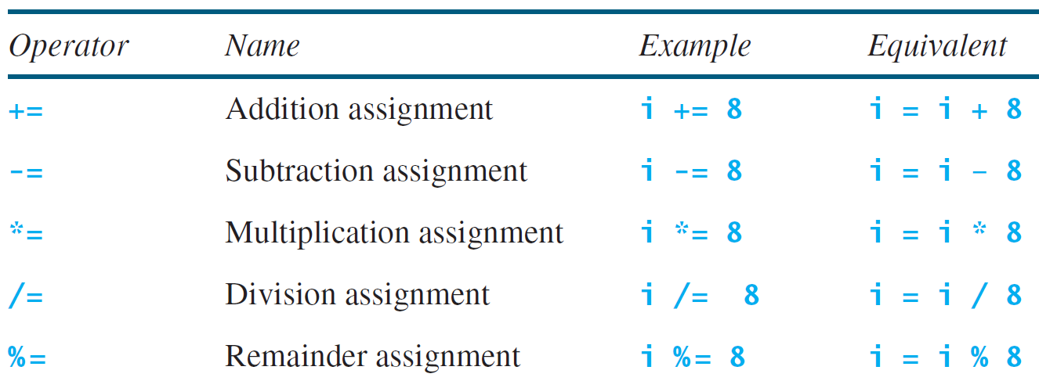
Augmented Assignment Operators

Slide 34
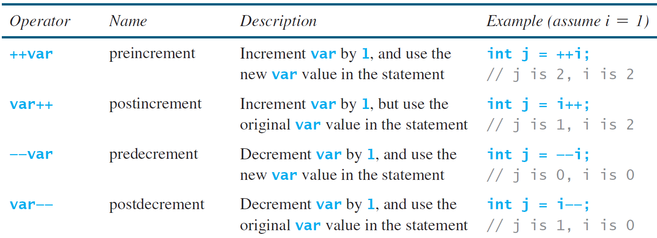
Increment and
Decrement Operators

Slide 35


Increment and
Decrement Operators, cont.

Slide 36
Increment and
Decrement Operators, cont.
Using increment and decrement operators makes expressions short, but it also makes them complex and difficult to read. Avoid using these operators in expressions that modify multiple variables, or the same variable for multiple times such as this: int k = ++i + i.

Slide 37
Assignment Expressions and Assignment Statements
Prior to Java 2, all the expressions can be used as statements. Since Java 2, only the following types of expressions can be statements:
variable op= expression; // Where op is +, -, *, /, or %
++variable;
variable++;
--variable;
variable--;

Slide 38
Numeric Type Conversion
Consider the following statements:
byte i = 100;
long k = i * 3 + 4;
double d = i * 3.1 + k / 2;

Slide 39
Conversion Rules
When performing a binary operation involving two operands of different types, Java automatically converts the operand based on the following rules:
1. If one of the operands is double, the other is converted into double.
2. Otherwise, if one of the operands is float, the other is converted into float.
3. Otherwise, if one of the operands is long, the other is converted into long.
4. Otherwise, both operands are converted into int.

Slide 40
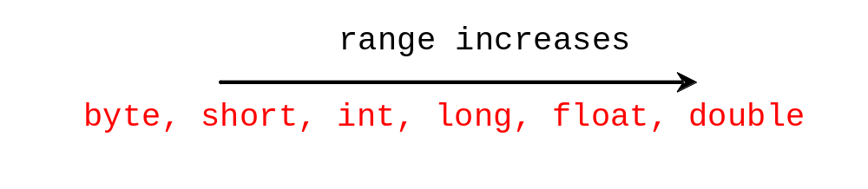
Type Casting
Implicit casting
double d = 3; (type widening)
Explicit casting
int i = (int)3.0; (type narrowing)
int i = (int)3.9; (Fraction part is truncated)
What is wrong? int x = 5 / 2.0;

Slide 41
Problem: Keeping Two Digits After Decimal Points
Write a program that displays the sales tax with two digits after the decimal point.

Slide 42
Casting in an Augmented Expression
In Java, an augmented expression of the form x1 op= x2 is implemented as x1 = (T)(x1 op x2), where T is the type for x1. Therefore, the following code is correct.
int sum = 0;
sum += 4.5; // sum becomes 4 after this statement
sum += 4.5 is equivalent to sum = (int)(sum + 4.5).

Slide 43
Bitwise Operators

Slide 44
Java Bitwise Operators
Java has six bitwise operators:
Symbol | Operator
& | Bitwise AND
| | Bitwise OR
^ | Bitwise XOR
~ | Bitwise NOT
<< | LEFT SHIFT
>> | RIGHT SHIFT
CS 160, Spring Semester 2014

Slide 45
Java AND and OR
AND operator (&) OR operator (|)
A | B | A & B
0 | 0 | 0
0 | 1 | 0
1 | 0 | 0
1 | 1 | 1
A | B | A | B
0 | 0 | 0
0 | 1 | 1
1 | 0 | 1
1 | 1 | 1
CS 160, Spring Semester 2014

Slide 46
Java XOR and NOT
XOR operator (^) NOT operator (~)
A | B | A ^ B
0 | 0 | 0
0 | 1 | 1
1 | 0 | 1
1 | 1 | 0
A | ~A
0 | 1
1 | 0
CS 160, Spring Semester 2014

Slide 47
Binary to Decimal
Decimal | Binary | Decimal | Binary
0 | 0000b | 8 | 1000b
1 | 0001b | 9 | 1001b
2 | 0010b | 10 | 1010b
3 | 0011b | 11 | 1011b
4 | 0100b | 12 | 1100b
5 | 0101b | 13 | 1101b
6 | 0110b | 14 | 1110b
7 | 0111b | 15 | 1111b
CS 160, Spring Semester 2014

Slide 48
Binary to Decimal
0-9 are used for decimal numbers (base-10):
  149 = 1*10² + 4*10¹ + 9*10⁰
0-1 are used for binary numbers (base-2):
  1010b = 1*2³ + 0*2² + 1*2¹ + *2⁰ = 8 + 2 = 10
Example:
  10111b in decimal?
  1*2⁴ + 0*2³ + 1*2² + 1*2¹ + 1*2¹ = 16 + 4 + 2 + 1 = 23
  What is 14 in binary?
  8 + 4 + 2 = 1*2³ + 1*2² + 1*2¹ + 0*2⁰ = 1110b
CS 160, Spring Semester 2014

Slide 49
Bitwise Operator Examples
4-bit numbers:
  6 & 5 = 0110b & 0101b = 0100b = 4
  6 | 5 = 0110b | 0101b = 0111b = 7
  6 ^ 5 = 0110b ^ 0101b = 0011b = 3
  ~6 = ~0110b = 1001b = 9
8-bit numbers:
  6 << 3 = 00000110b << 3 = 00110000b = 48 (6 * 8)
  48 >> 4 = 00110000b >> 4 = 00000011b = 3 (48 / 16)
CS 160, Spring Semester 2014

Slide 50
Masking Operations
Clearing bits:
  x = 00101001b = 41
  want to clear top 4-bits
  x = x & 00001111b = x & 15 = 00001001b = 9
Setting bits:
  x = 00101001b = 41
  want to set bottom 4-bits
  x = x | 00001111b = x | 15 = 00101111b = 47
CS 160, Spring Semester 2014

Slide 51
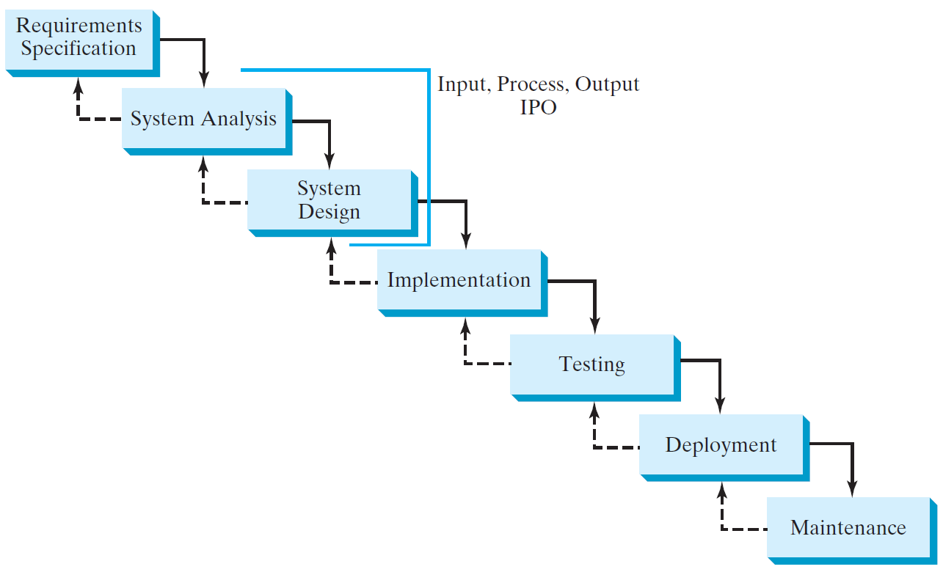
Software Development Process

Slide 52
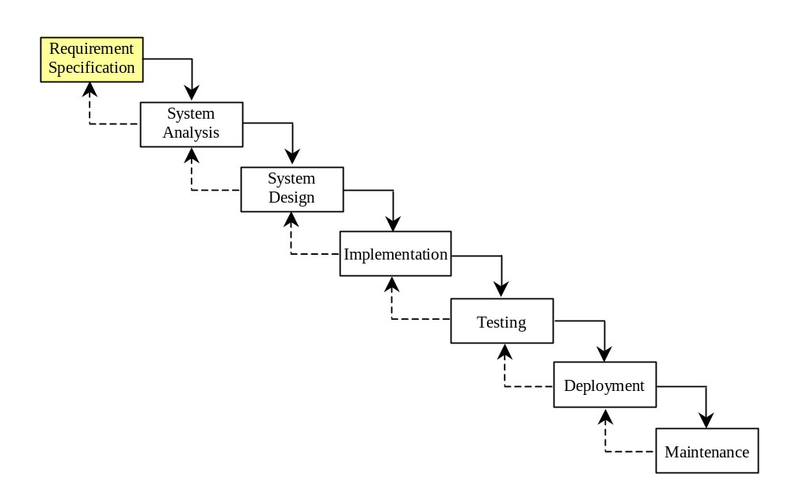
Requirement Specification
A formal process that seeks to understand the problem and document in detail what the software system needs to do. This phase involves close interaction between users and designers.
Most of the examples in this book are simple, and their requirements are clearly stated. In the real world, however, problems are not well defined. You need to study a problem carefully to identify its requirements.

Slide 53
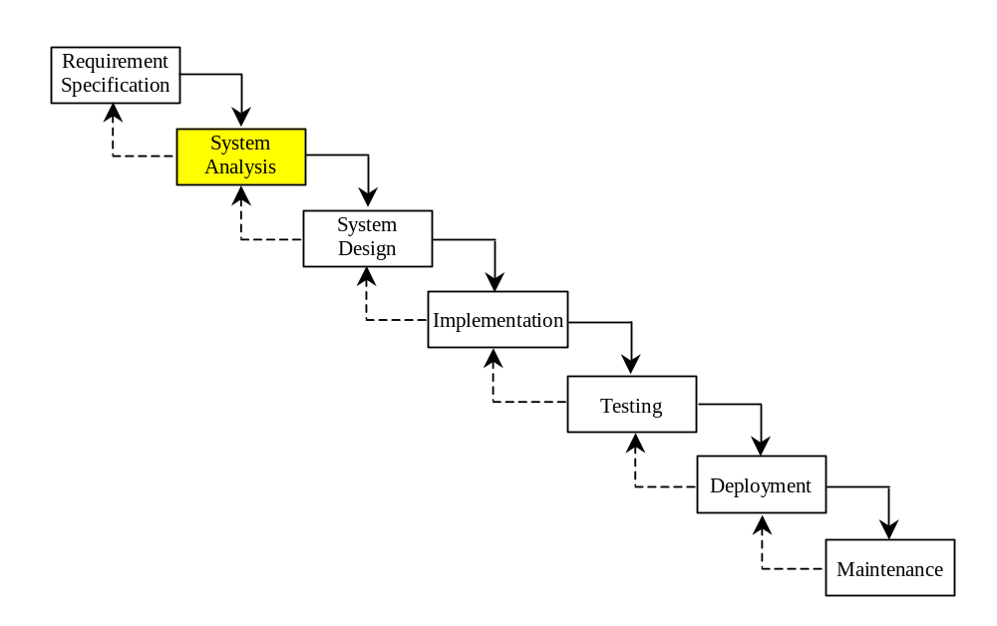
System Analysis
Seeks to analyze the business process in terms of data flow, and to identify the system’s input and output.
Part of the analysis entails modeling the system’s behavior. The model is intended to capture the essential elements of the system and to define services to the system.

Slide 54
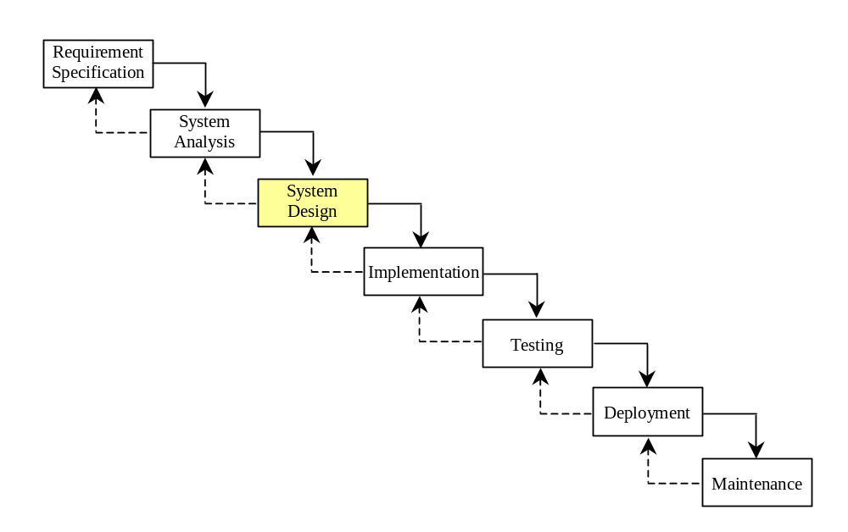
System Design
The process of designing the system’s components.
This phase involves the use of many levels of abstraction to decompose the problem into manageable components, identify classes and interfaces, and establish relationships among the classes and interfaces.

Slide 55
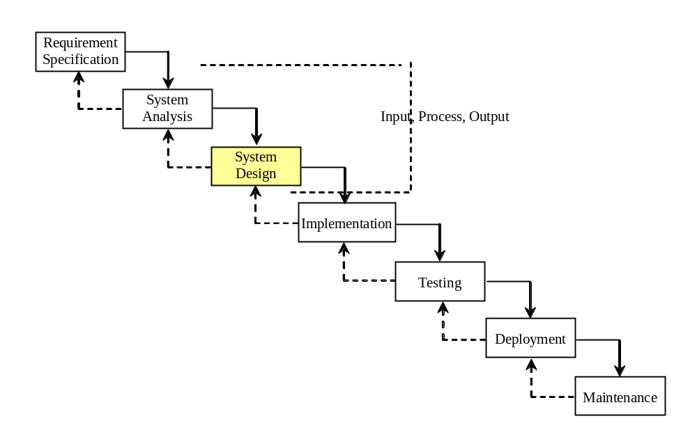
IPO
The essence of system analysis and design is input, process, and output. This is called IPO.

Slide 56
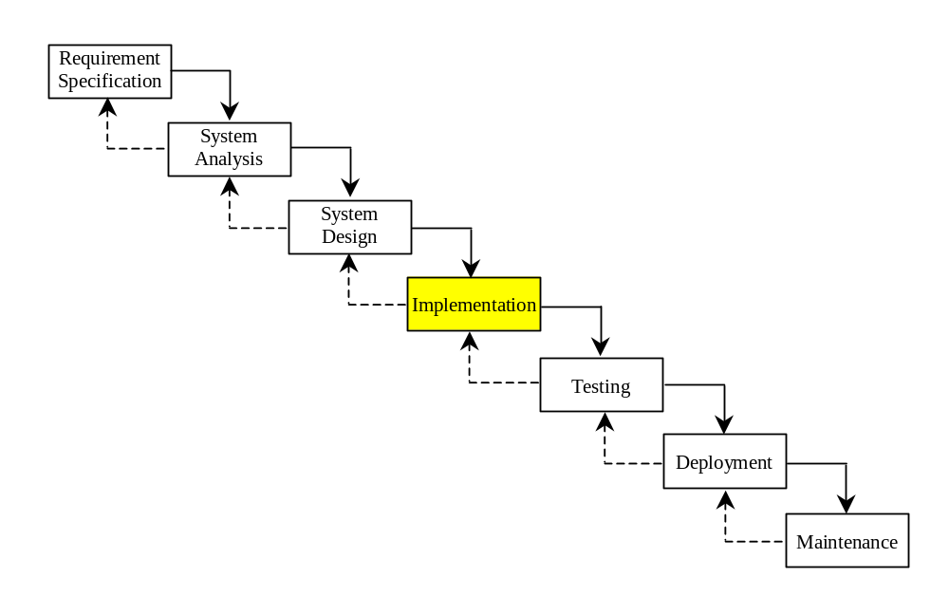
Implementation
The process of translating the system design into programs. Separate programs are written for each component and put to work together.
This phase requires the use of a programming language like Java. The implementation involves coding, testing, and debugging.

Slide 57
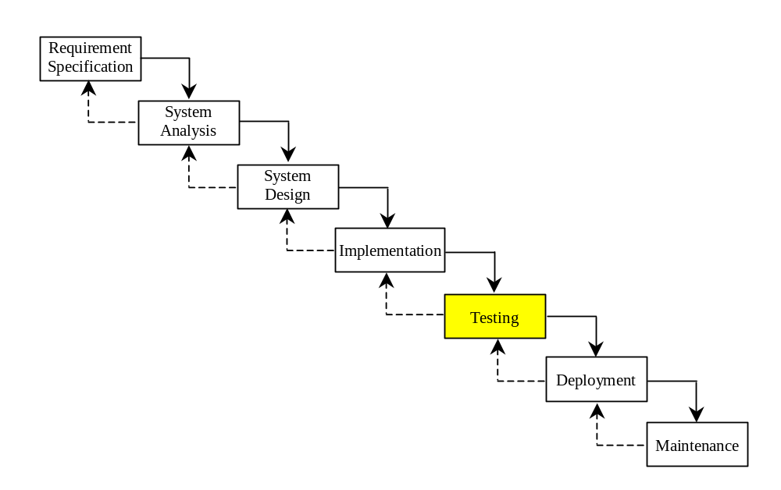
Testing
Ensures that the code meets the requirements specification and weeds out bugs.
An independent team of software engineers not involved in the design and implementation of the project usually conducts such testing.

Slide 58
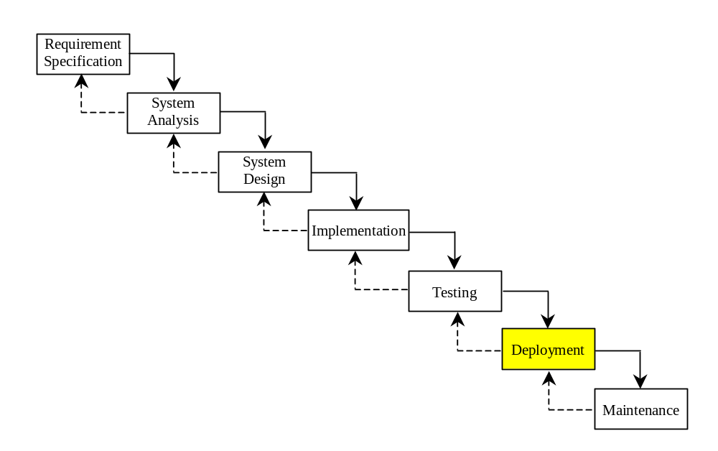
Deployment
Deployment makes the project available for use.
For a Java program, this means installing it on a desktop or on the Web.

Slide 59
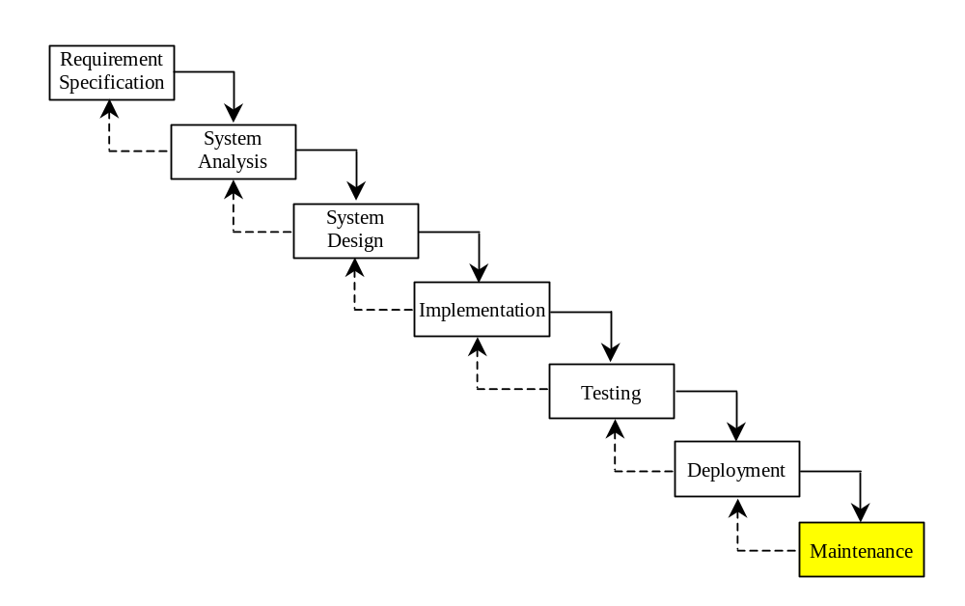
Maintenance
Maintenance is concerned with changing and improving the product.
A software product must continue to perform and improve in a changing environment. This requires periodic upgrades of the product to fix newly discovered bugs and incorporate changes.

Slide 60

Problem:
Computing Loan Payments
This program lets the user enter the interest rate, number of years, and loan amount, and computes monthly payment and total payment.

Slide 61
Problem: Monetary Units
This program lets the user enter the amount in decimal representing dollars and cents and output a report listing the monetary equivalent in single dollars, quarters, dimes, nickels, and pennies. Your program should report maximum number of dollars, then the maximum number of quarters, and so on, in this order.

Slide 62
Common Errors and Pitfalls
Common Error 1: Undeclared/Uninitialized Variables and Unused Variables
Common Error 2: Integer Overflow
Common Error 3: Round-off Errors
Common Error 4: Unintended Integer Division
Common Error 5: Redundant Input Objects
Common Pitfall 1: Redundant Input Objects

Slide 63
Common Error 1: Undeclared/Uninitialized Variables and Unused Variables
double interestRate = 0.05;
double interest = interestrate * 45;

Slide 64
Common Error 2: Integer Overflow
int value = 2147483647 + 1;
// value will actually be -2147483648

Slide 65
Common Error 3: Round-off Errors
System.out.println(1.0 - 0.1 - 0.1 - 0.1 - 0.1 - 0.1);
System.out.println(1.0 - 0.9);

Slide 66
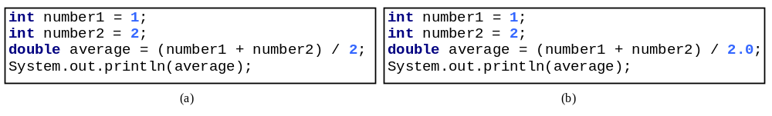
Common Error 4: Unintended Integer Division

Slide 67
Common Pitfall 1: Redundant Input Objects
Scanner input = new Scanner(System.in);
System.out.print("Enter an integer: ");
int v1 = input.nextInt();
Scanner input1 = new Scanner(System.in);
System.out.print("Enter a double value: ");
double v2 = input1.nextDouble();

Slide 68
Random numbers

Slide 69
The Random class
Objects of the Random class generate pseudo-random numbers.
  Class Random is found in the java.util package.
  import java.util.*;
The methods of a Random object
Method name
Description
nextInt()‏
returns a random integer
nextInt(max)‏
returns a random integer in the range [0, max)‏
in other words, from 0 to one less than max
nextDouble()‏
returns a random real number in the range [0.0, 1.0)‏

Slide 70
Generating random numbers
  Random rand = new Random();
  int randomNum = rand.nextInt(10);
  // randomNum has a random value between 0 and 9
What if we wanted a number from 1 to 10?
int randomNum = rand.nextInt(10) + 1;
What if we wanted a number from min to max (i.e. an arbitrary range)?
  int randomNum = rand.nextInt(<size of the range>) + <min>
  where <size of the range> equals (<max> - <min> + 1)‏

Slide 71
Random questions
Given the following declaration, how would you get:
    Random rand = new Random();
  A random number between 0 and 100 inclusive?
  A random number between 1 and 100 inclusive?
  A random number between 4 and 17 inclusive?

Slide 72
Random solutions
Given the following declaration, how would you get:
  Random rand = new Random();
  A random number between 0 and 100 inclusive?
  int random1 = rand.nextInt(101);
  A random number between 1 and 100 inclusive?
  int random1 = rand.nextInt(100) + 1;
  A random number between 4 and 17 inclusive?
  int random1 = rand.nextInt(14) + 4;

